Slide 1
HRSA Flex EMS Supplemental Grant Project
February 9, 2023
NEMSQA Learning Session 2

Slide 2
Objectives
The First Objective
Review Michigan EMS data flow
The Second Objective
Understand the next 3 measures: Stroke 01, Seizure 02, and Trauma 04
The Third Objective
Review the EMS agency baseline data and understand the related ePCR documentation

Slide 3
Data Flow
States and software companies create products that are used to send and receive EMS data in the proper XML format from agencies to states, then on to the National EMS Database.
Local Agencies select elements according to their needs—keeping the national elements AND state elements as part of their selected elements.
2. States select elements from the NEMSIS Dataset according to their needs—keeping the national elements as part of their selection.
3. The national elements are transmitted to the NEMSIS TAC to populate the National EMS Dataset.

Slide 4
Learning Session 2 NEMSQA Measures
Seizures 02 measure criteria
Percentage of EMS responses originating from a 911, intercept, or mutual aid request for patients with status epilepticus who received benzodiazepine.
Numerator/Denominator
NEMSIS documentation area: medications
Stroke 01 measure criteria
Percentage of EMS responses originating from a 911, intercept, or mutual aid request for patients suffering from a suspected stroke who had a stroke assessment performed during the EMS response.
Numerator/Denominator
NEMSIS documentation area: exam
Trauma 04 measure criteria
Percentage of EMS responses originating from a 911, intercept, or mutual aid request for patients who meet CDC criteria for trauma and are transported to a trauma center.
Numerator/Denominator
NEMSIS documentation area: disposition

Slide 5
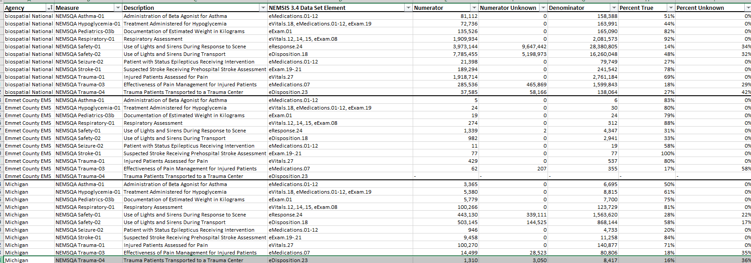
Your EMS Data

Slide 6
Your EMS Data
Service level

Slide 7
The Impact of Clinical Documentation
Clinical field documentation matters.
Let’s look at a few EPCR examples in our software vendors:
ESO
Elite
We will want to take this information back to our personnel to improve clinical documentation and potentially make changes to vendor fields.

Slide 8
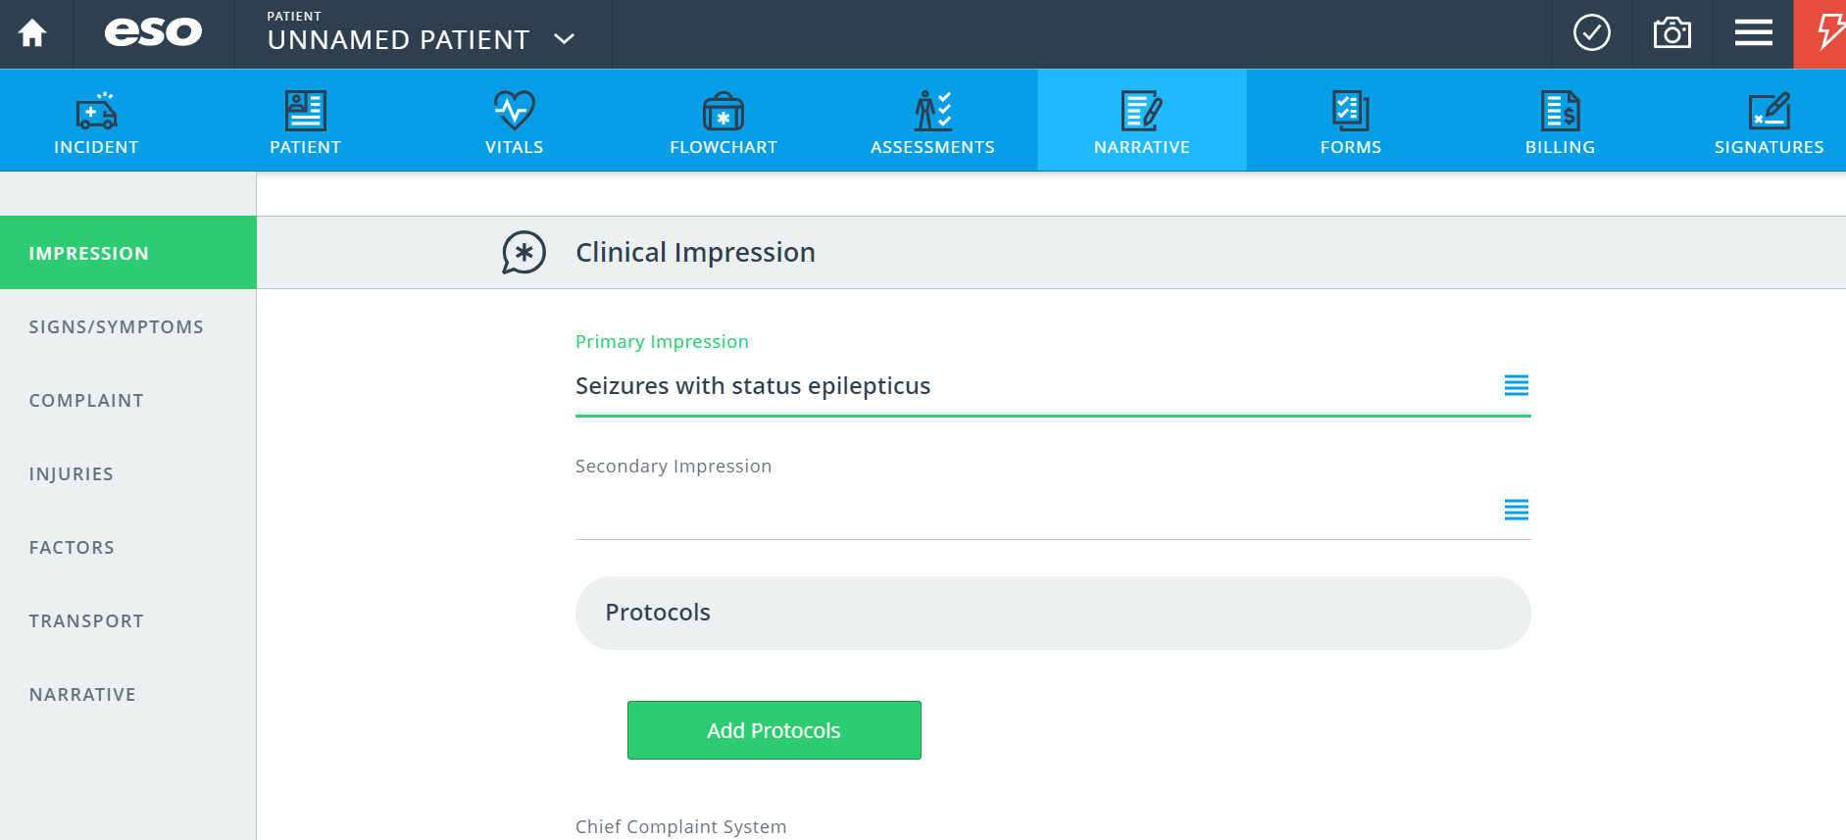
ESO: Medications (NEMSQA Seizure 02)

Slide 9
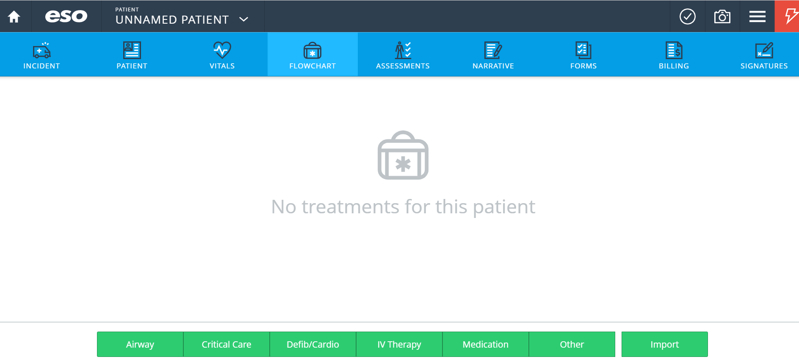
ESO: Medications (NEMSQA Seizure 02)

Slide 10
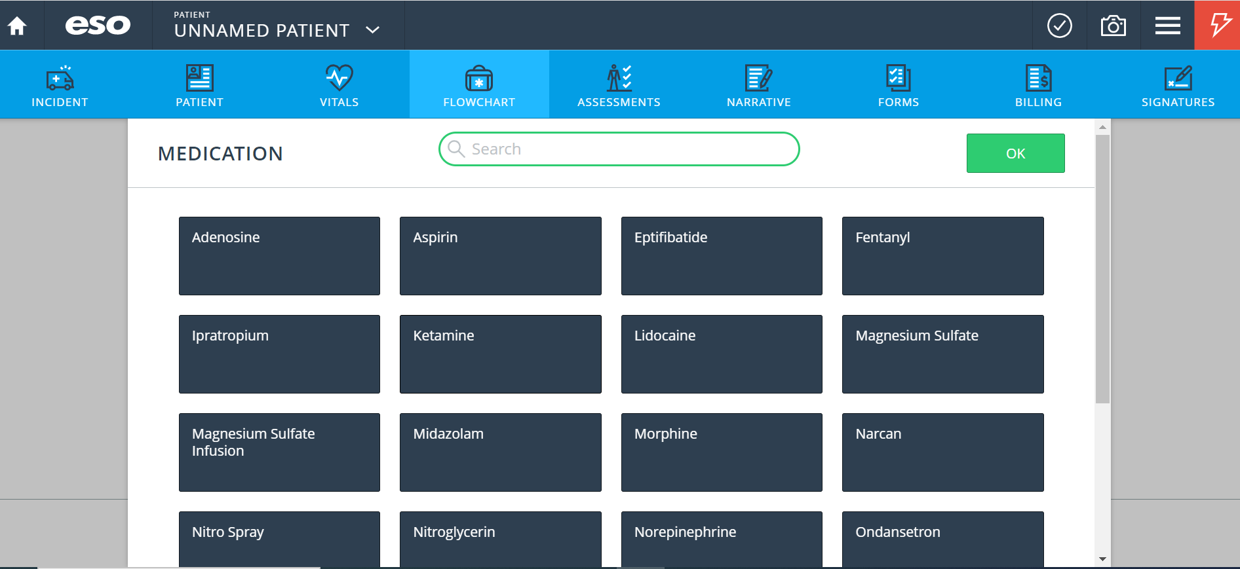
ESO: Medications (NEMSQA Seizure 02)

Slide 11
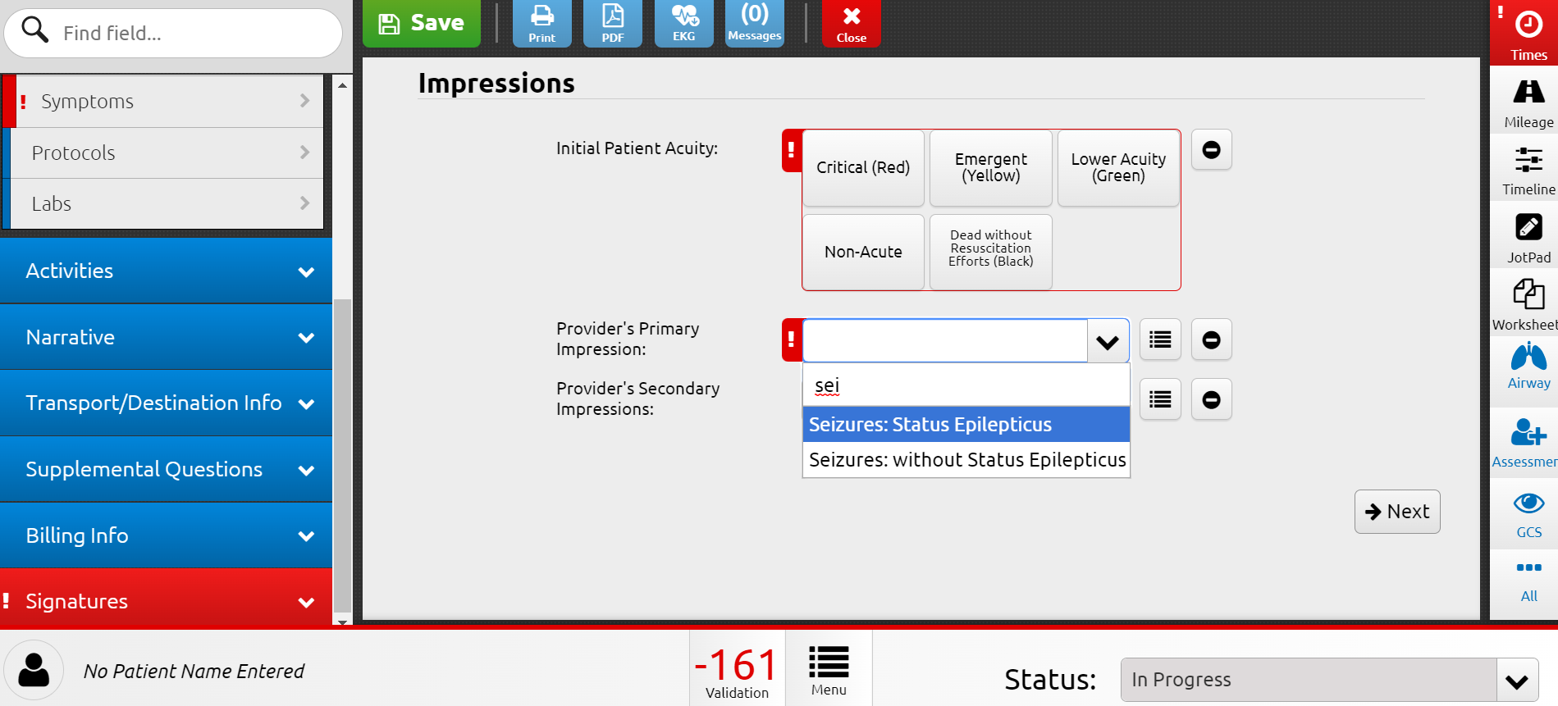
Elite: Medications (NEMSQA Seizure 02)

Slide 12
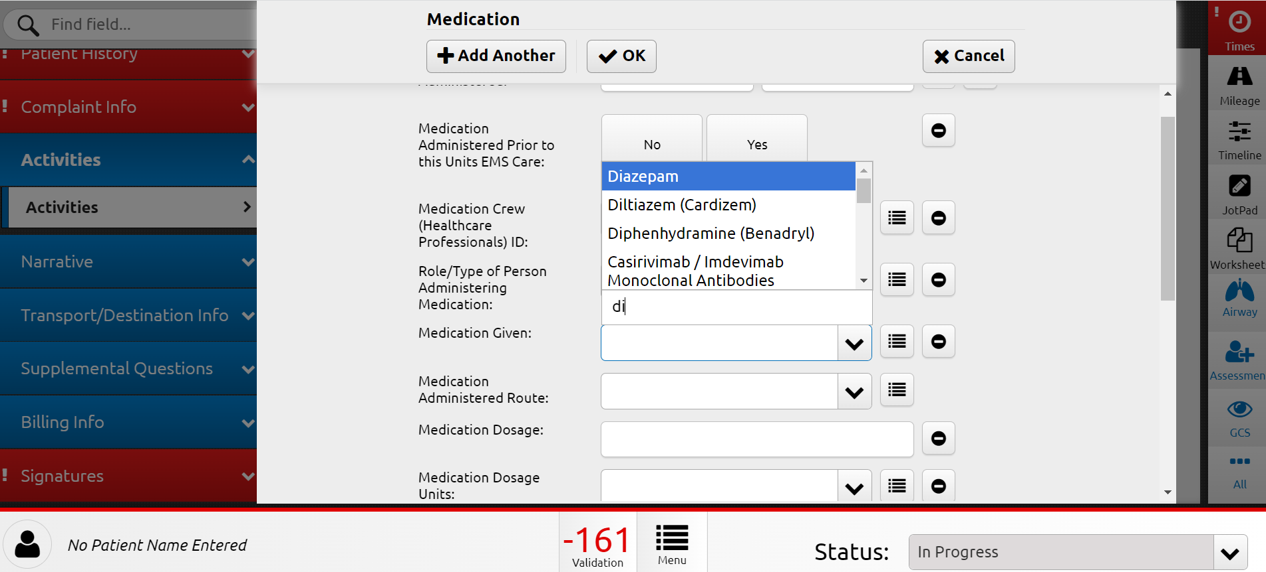
Elite: Medications (NEMSQA Seizure 02)

Slide 13
ESO: Exam (NEMSQA Stroke 1)

Slide 14
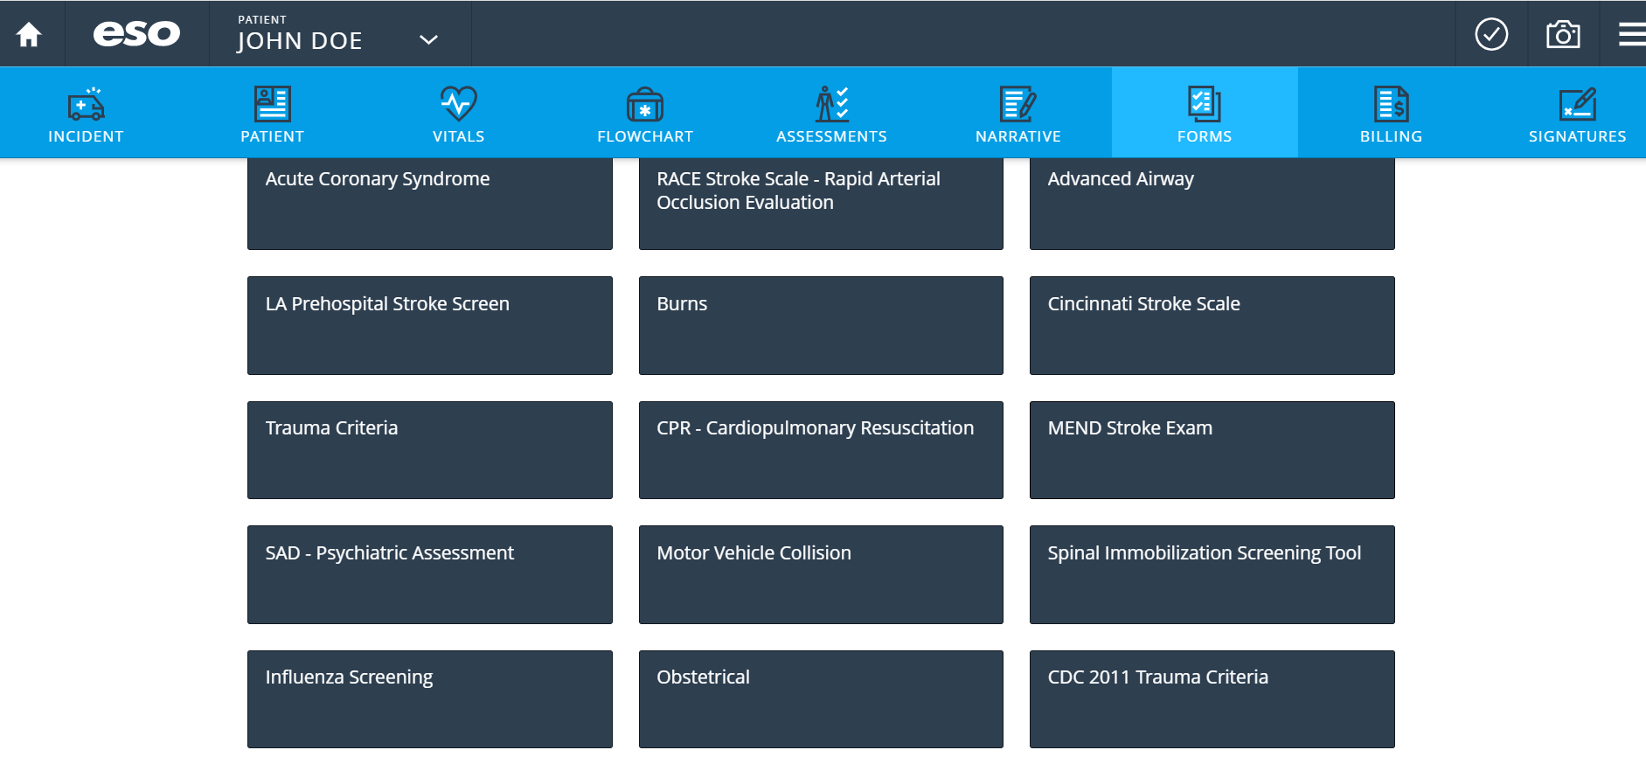
ESO: Exam (NEMSQA Stroke 1)

Slide 15
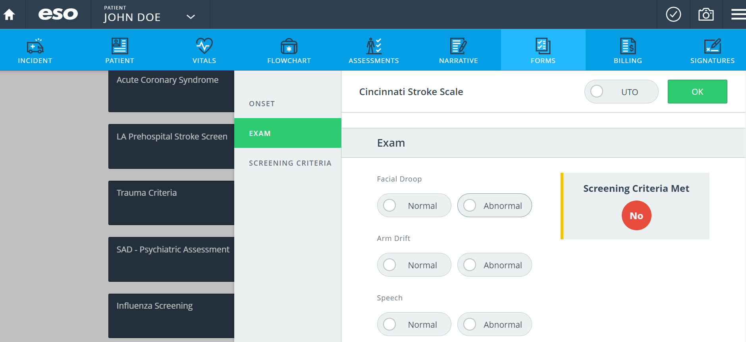
ESO: Exam (NEMSQA Stroke 1)

Slide 16
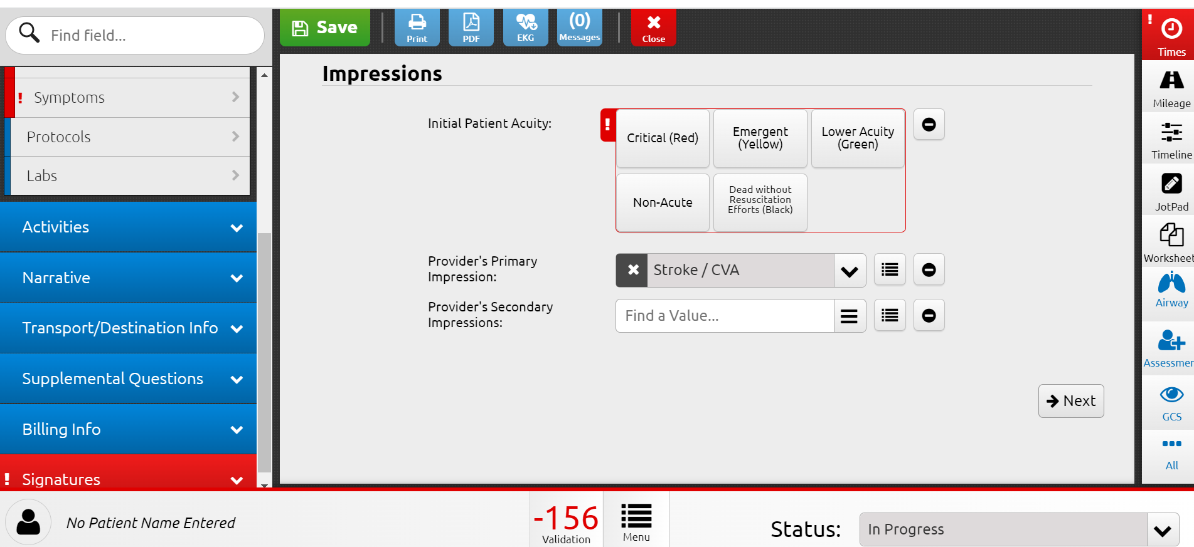
Elite: Exam (NEMSQA Stroke 1)

Slide 17
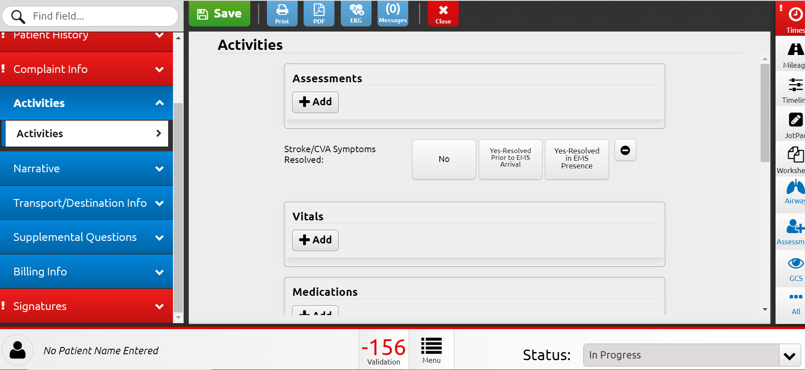
Elite: Exam (NEMSQA Stroke 1)

Slide 18
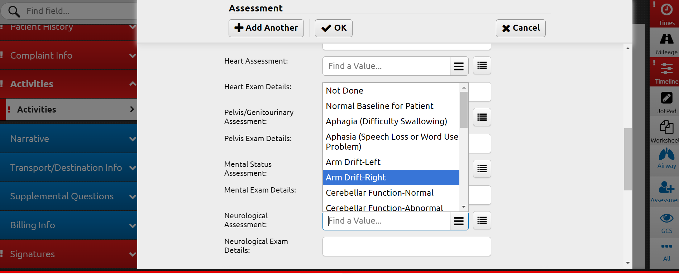
Elite: Exam (NEMSQA Stroke 1)

Slide 19
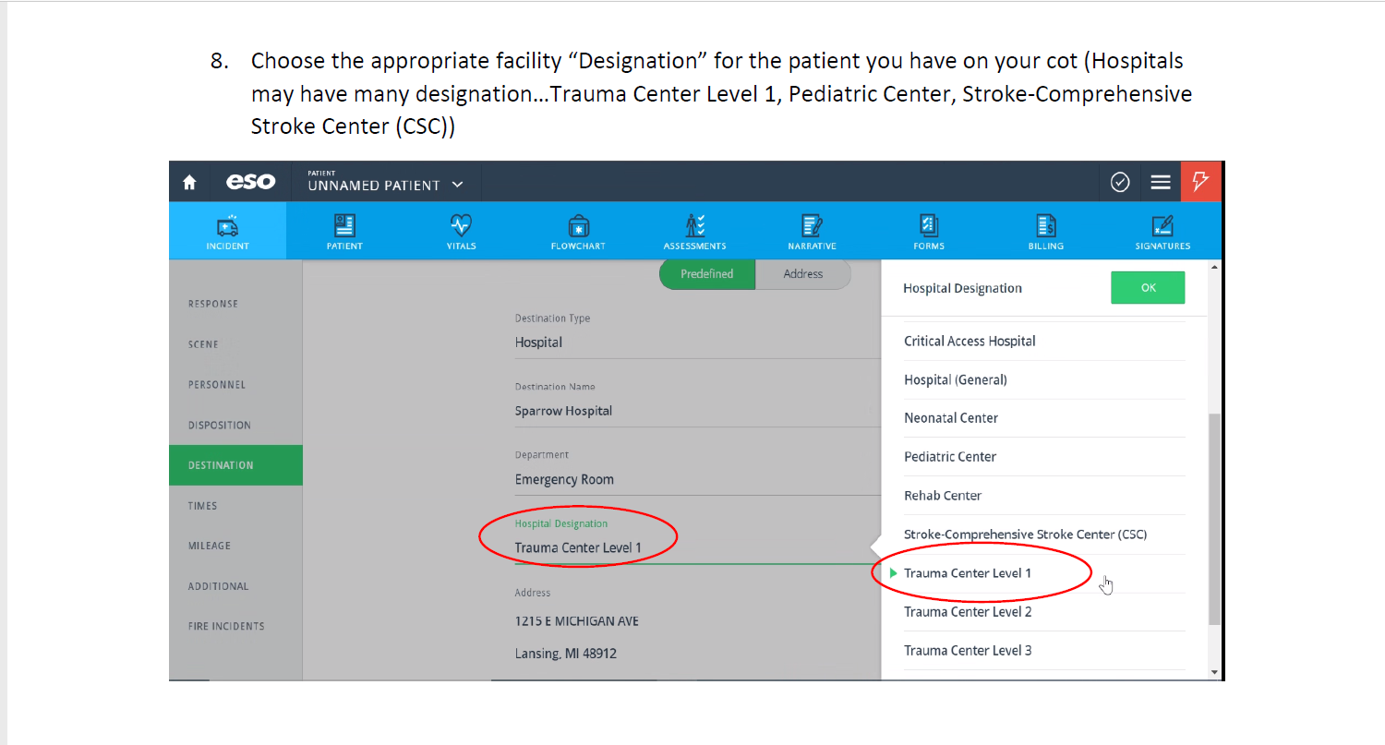
ESO: Exam (NEMSQA Trauma 04)

Slide 20
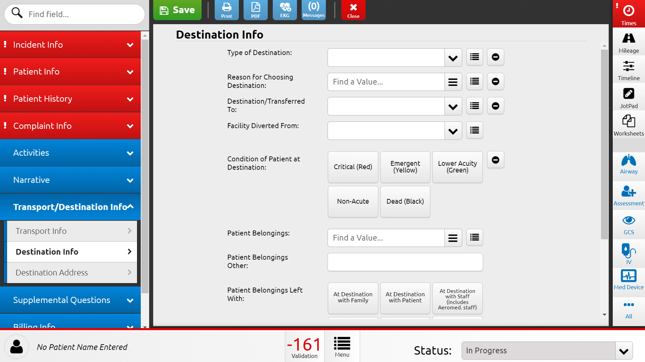
Elite: Exam (NEMSQA Trauma 04)

Slide 21
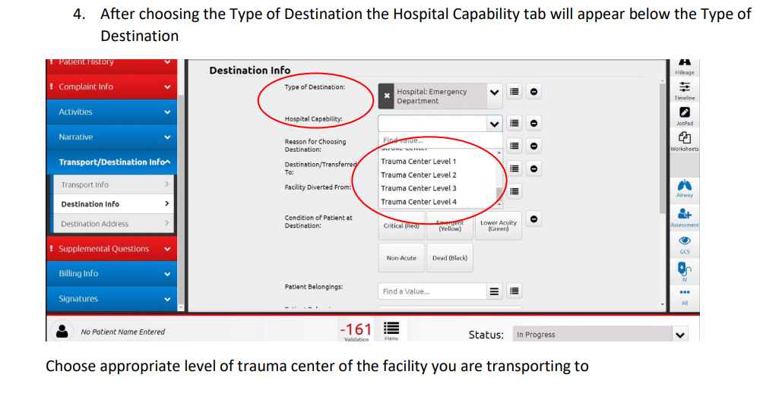
ESO: Exam (NEMSQA Trauma 04)

Slide 22
Conclusion
How can we improve the gaps in our data reporting?
Identify the data gap (s)
Discover what's causing the gap
Implement the solution over time

Slide 23
References
01
Michigan NEMSIS
https://nemsis.org/state-data-managers/state-map-v3/michigan/
02
NEMSQA
https://www.nemsqa.org/nemsqa-measures
03
ESO EHR
04
Image Trend Elite

Slide 24
Thank you!
Do you have any questions for us?

