Slide 1
HRSA Flex EMS Supplemental Grant Project
March 9, 2023
NEMSQA Learning Session 3

Slide 2
Objectives
The First Objective
Michigan EMS data flow
The Second Objective
Understand the next 3 measures: Safety 01, Safety 02, Pediatrics 03
The Third Objective
Review and discuss EMS raw data.

Slide 3
Data Flow
States and software companies create products that are used to send and receive EMS data in the proper XML format from agencies to states, then on to the National EMS Database.
Local Agencies select elements according to their needs—keeping the national elements AND state elements as part of their selected elements.
2. States select elements from the NEMSIS Dataset according to their needs—keeping the national elements as part of their selection.
3. The national elements are transmitted to the NEMSIS TAC to populate the National EMS Dataset.

Slide 4
Learning Session 3 NEMSQA Measures
Pediatrics 03 measure criteria
Percentage of EMS responses originating from a 911, intercept, or mutual aid request for patients less than 18 years of age who received a medication and had a documented weight in kilograms or length-based weight estimate documented during the EMS response.
Numerator/Denominator (refer to NEMSQA definitions)
NEMSIS documentation area: exam
Safety 01 measure criteria
Percentage of EMS responses originating from a 911, intercept, or mutual aid request in which lights and sirens were not used during response.
Numerator/Denominator
NEMSIS documentation area: response
Safety 02 measure criteria
Percentage of EMS transports originating from a 911, intercept, or mutual aid request during which lights and sirens were not used during patient transport.
Numerator/Denominator
NEMSIS documentation area: disposition

Slide 5
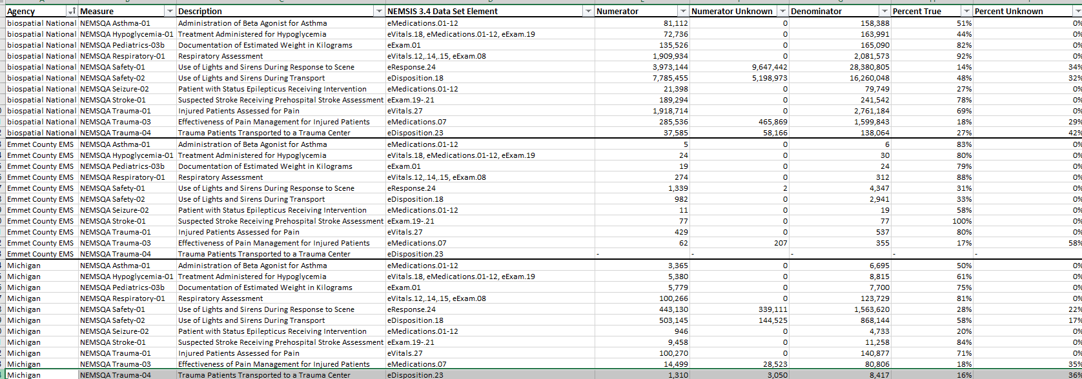
Your EMS Data

Slide 6
Your EMS Data
Service level

Slide 7
Let’s Review
What does the percent true signify?
What does the percent unknown signify?
What does the NEMSIS data element signify?
How can these metrics be impacted by your level of service, call volume, etc.?

Slide 8
The Impact of Clinical Documentation
Clinical field documentation matters.
Let’s look at a few EPCR examples in our software vendors:
ESO
Elite
Our focus:
NEMSQA Pediatrics 03
NEMSQA Safety 01
NEMSQA Safety 02

Slide 9
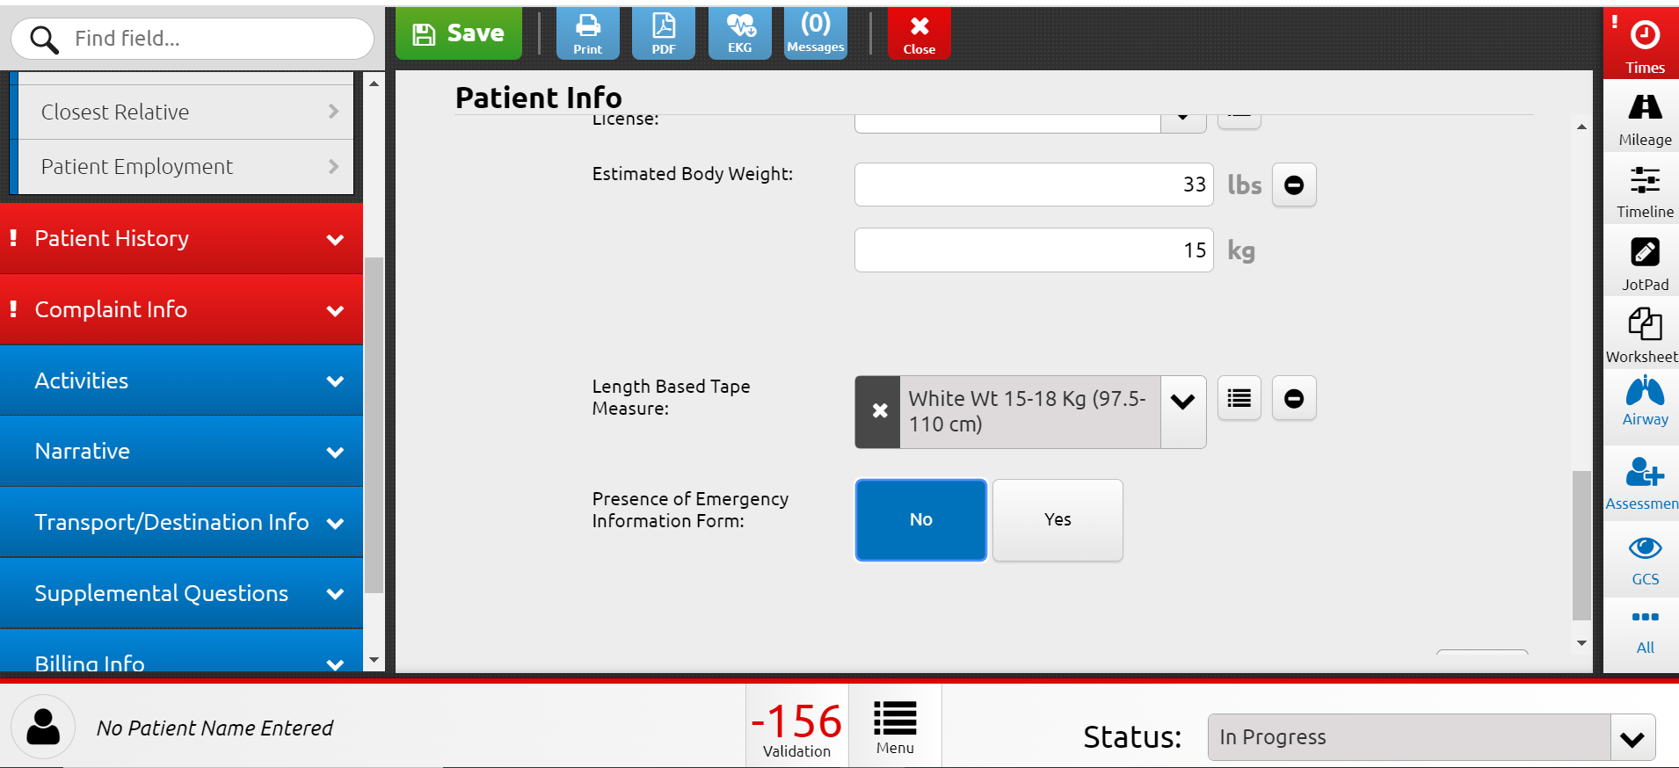
Elite: Pediatric 03 Weight

Slide 10
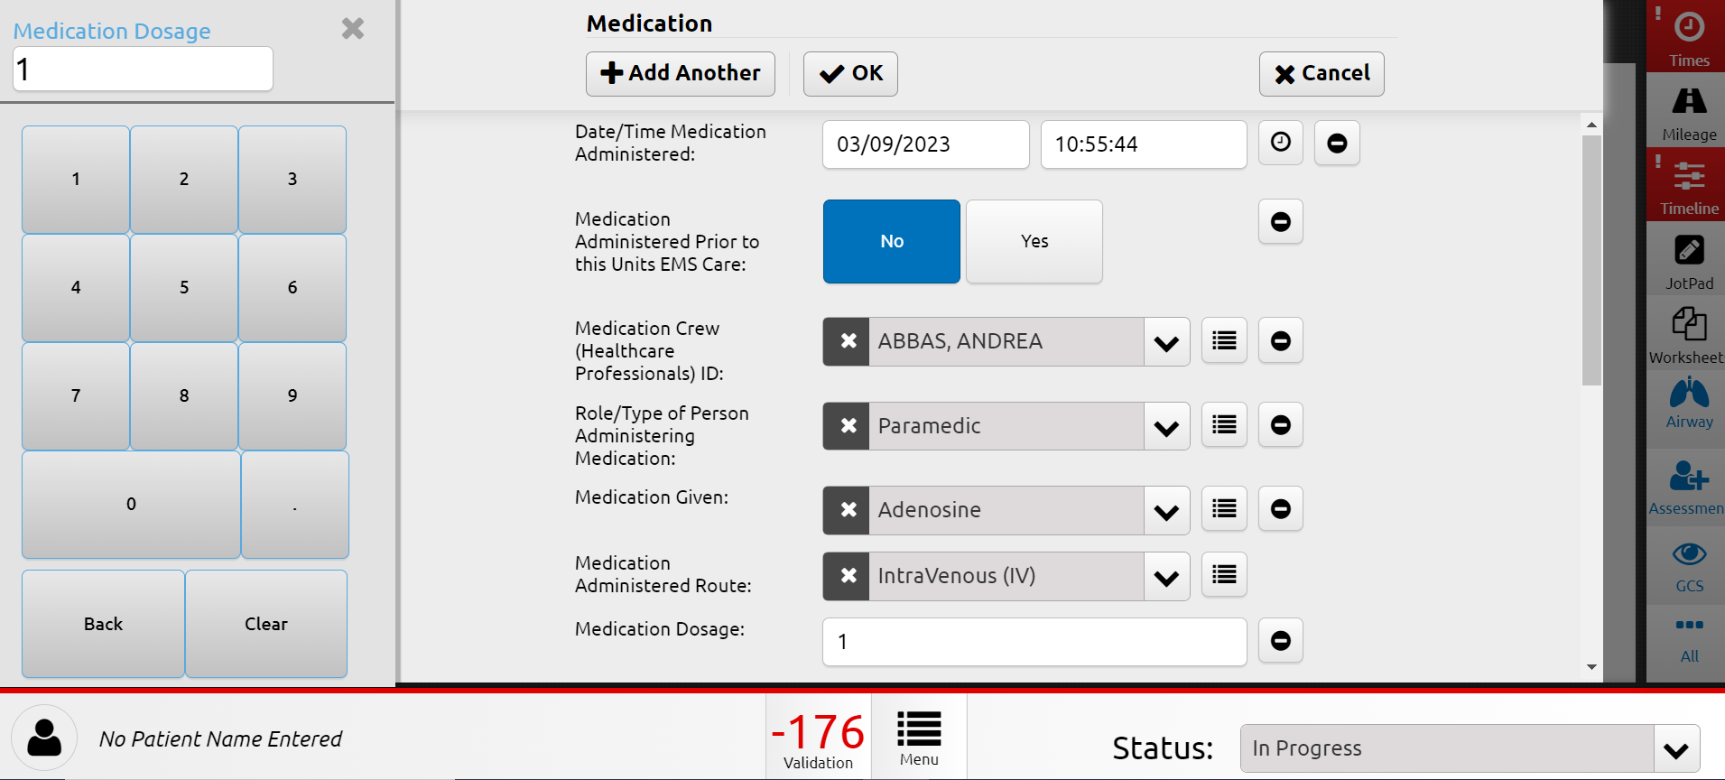
Elite: Pediatric 03 Medication

Slide 11
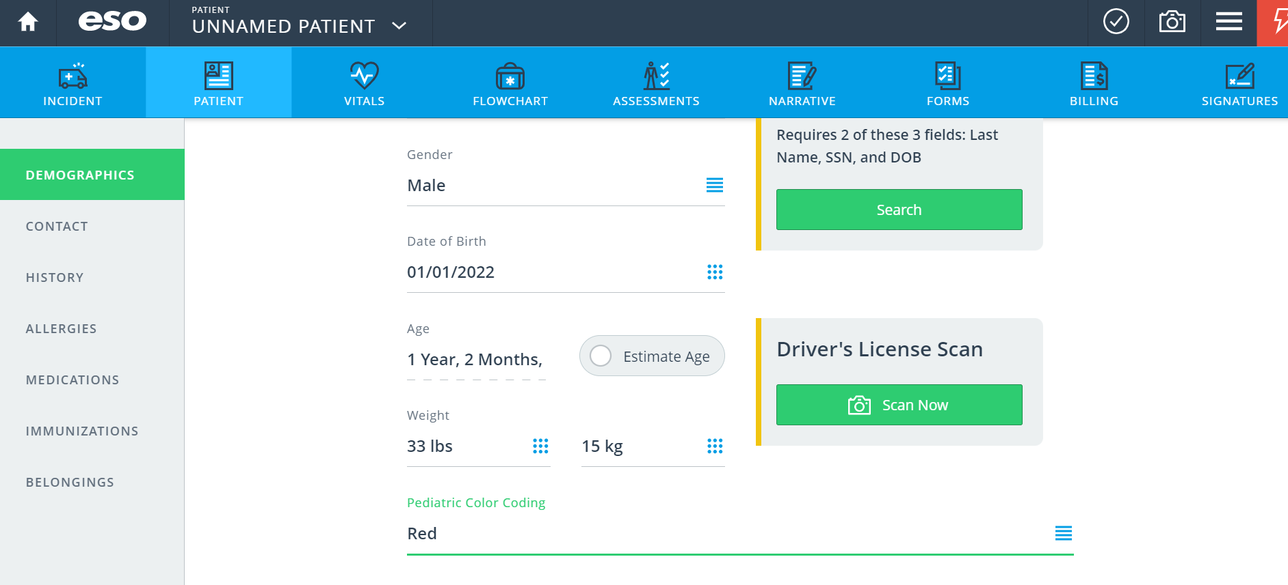
ESO: Pediatric 03 Weight

Slide 12
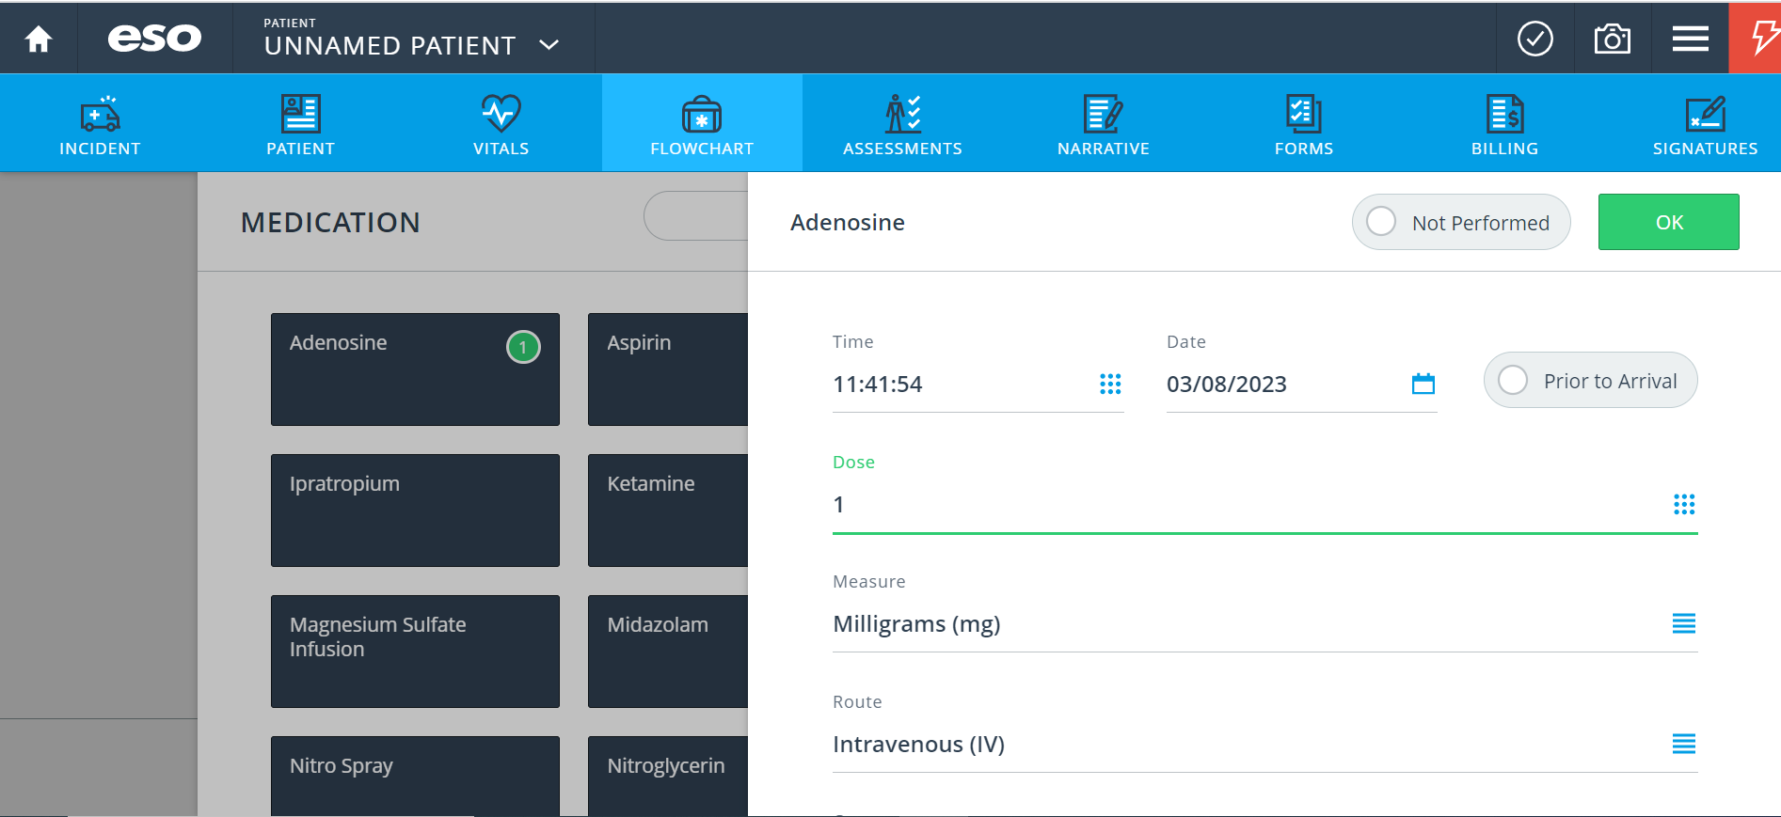
ESO: Pediatric 03 Medication

Slide 13
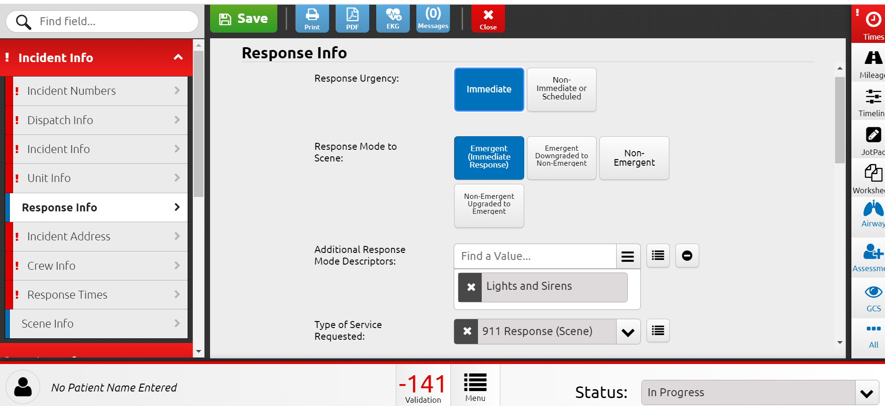
Elite: Safety 01 Response to Scene

Slide 14
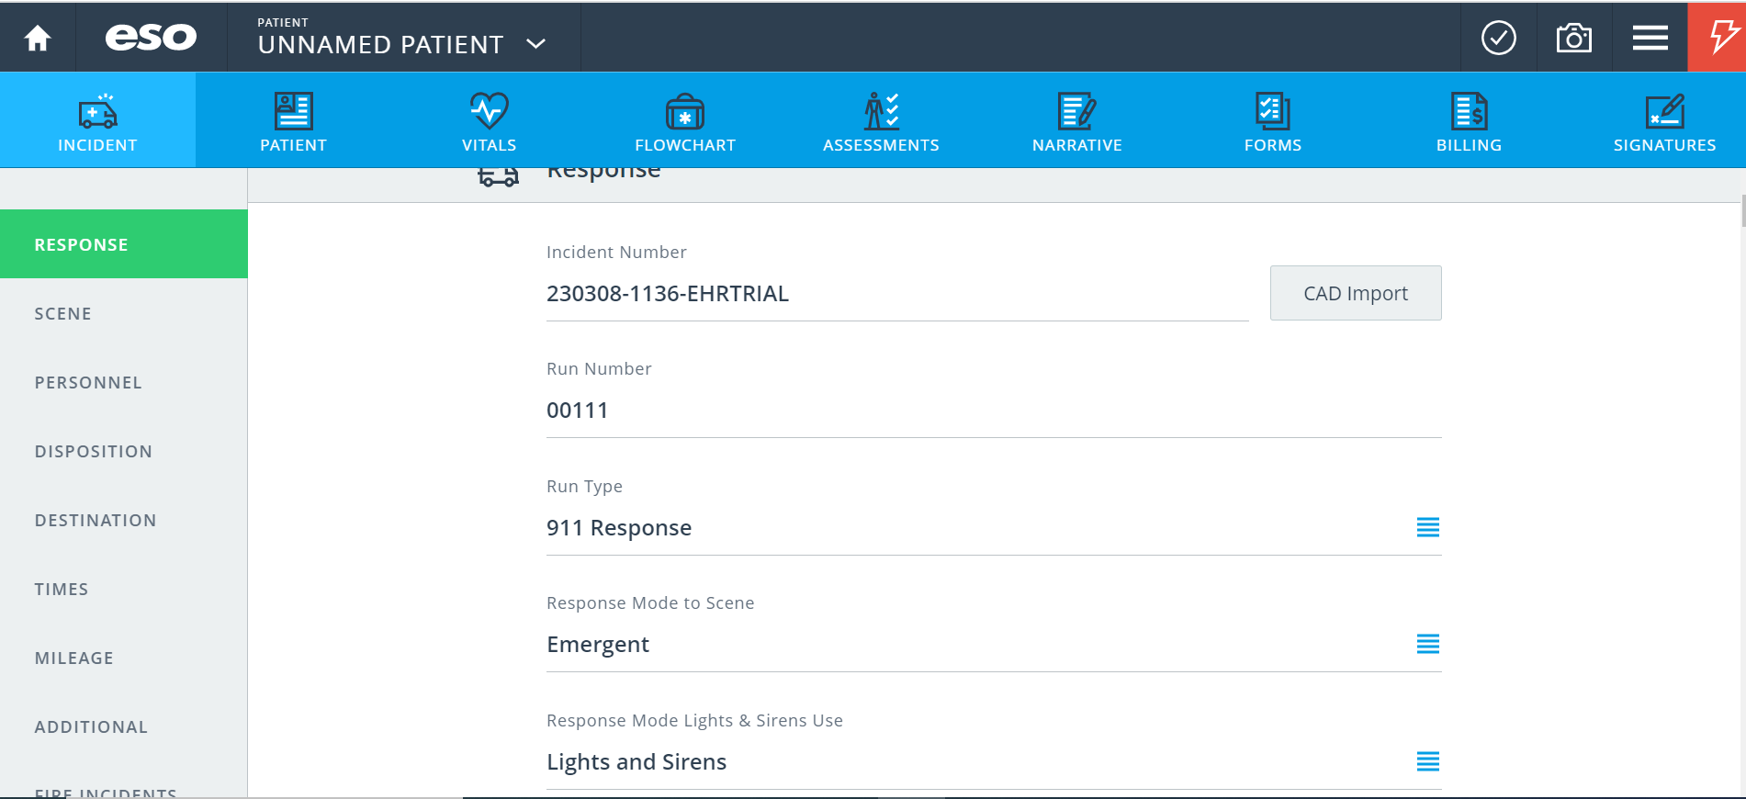
ESO: Safety 01 Response to Scene

Slide 15
The Use of Lights & Sirens
This spring 13 prominent EMS and firefighting leadership groups issued a joint position statement addressing the issue, which proposes several measures to reduce the unnecessary use of lights and sirens. With this many credible authorities behind the proposals, the use of lights and sirens in EMS response and transport is going to change.
Despite these alarming statistics, L&S continue to be used in 74% of EMS responses, and 21.6% of EMS transports, with a wide variation in L&S use among agencies and among census districts in the United States (10). Although L&S response is currently common to medical calls, few (6.9%) of these result in a potentially lifesaving intervention by emergency practitioners (12). Some agencies have used an evidence-based or quality improvement approach to reduce their use of L&S during responses to medical calls to 20-33%, without any discernable harmful effect on patient outcome

Slide 16
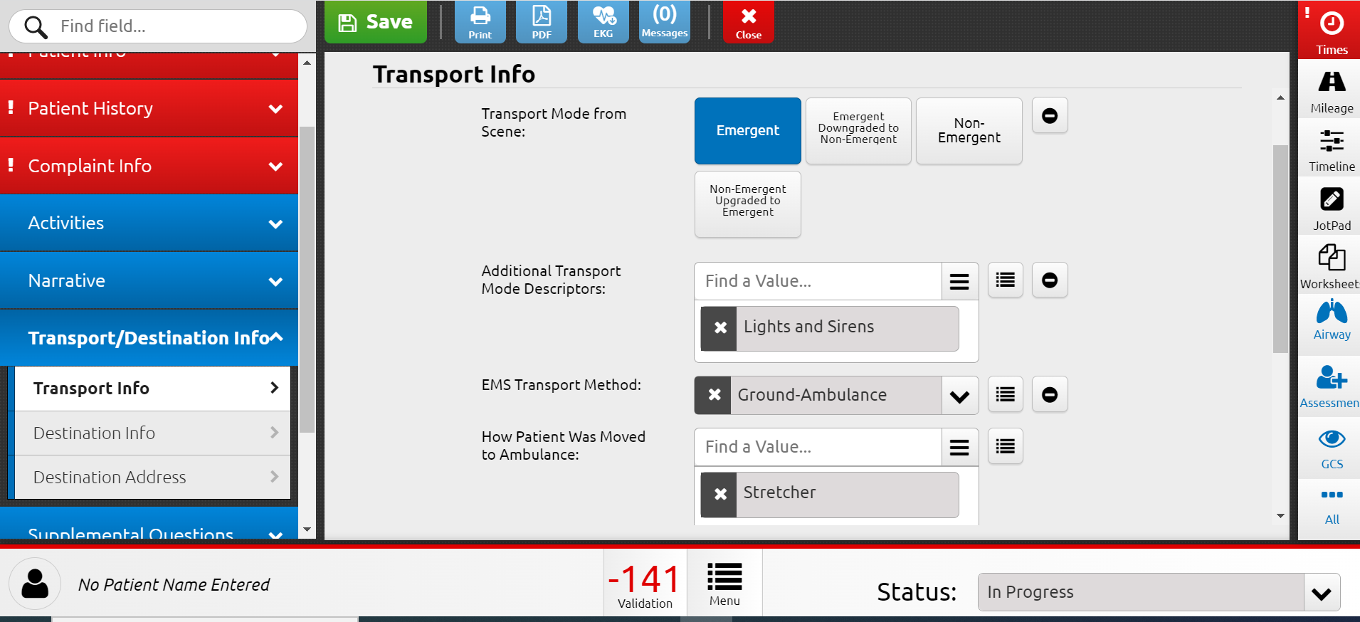
Elite: Safety 02 Transport Disposition

Slide 17
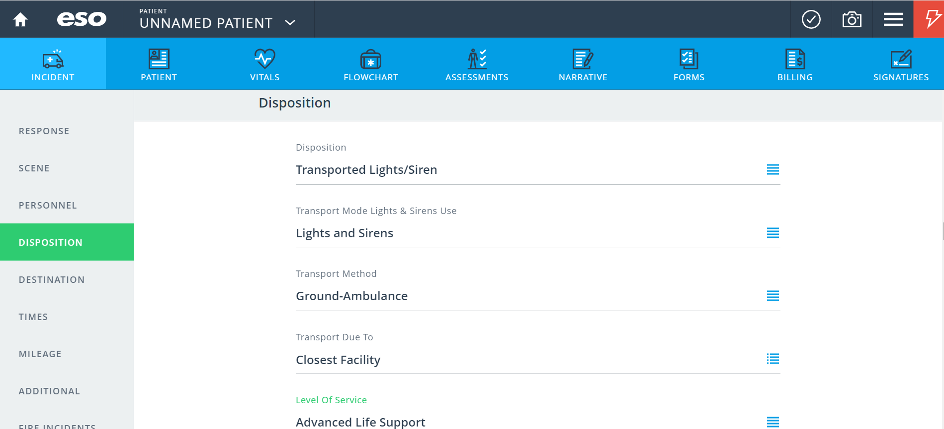
ESO: Safety 02 Transport Disposition

Slide 18
Conclusion
How can we improve the gaps in our data reporting?
Identify the data gap (s)
Discover what's causing the gap
Implement the solution over time

Slide 19
01
Michigan NEMSIS
https://nemsis.org/state-data-managers/state-map-v3/michigan/
References
02
NEMSQA
https://www.nemsqa.org/nemsqa-measures
03
Joint Statement on Lights and Sirens Vehicle Operations
NAEMSP.org
04
ESO EHR
05
Image Trend Elite

Slide 20
Thank you!
Do you have any questions for us?

